Slide 1


Customer Retention Case Study
Group
Amit
Sai Rakesh
Narmada Kumar
L.Divya
Shaik Mohammad Arif
Bhawna Gupta
Ankita

Slide 2

Planning the Process
Section 1
Business Objective understanding and High-level Approach
Section 2
Data Health Review
Section 3
Section 4
Section 5
Exploratory Data Analysis
KPI/ Metric based questions
Open-ended questions and Approaches

Slide 3

Business Objective Understanding and High-level Approach
Problem Statement:
The company needs to understand the status of its existing customers by analyzing the retention rate and avoiding churn based on the transaction behavior of the customer.
Business Objective:
The company is trying to avoid churn by retaining existing customers by analyzing the transaction behavior of the customer.
High-Level Approach:
To achieve the business objective and address the problem, the bank can take the following approach:
Data Collection
Define Churn
Identify Inactive to Active Customers
Segment Customers
Analyze Transaction Behavior
Identify Key Indicators

Slide 4

Detailed High-Level Approach
Data Collection: Gather customer transaction data and relevant customer information such as account activity, transaction frequency, transaction amounts, and other relevant variables that may impact churn.
Define Churn: Develop a clear definition of churn for the bank, which may be based on a specific period of inactivity or a decrease in transaction frequency. This will help in identifying customers who have turned from active to inactive.
Identify Inactive to Active Customers: Analyze the customer data to identify customers who have turned from inactive to active. This can be done by setting criteria for reactivation, such as an increase in transaction frequency or reaching a specific threshold of activity.
Segment Customers: Divide the customer base into two segments: those who turned from active to inactive and those who turned from inactive to active over a period of six months. This will allow for a comparison between the two groups to identify any key differences or patterns.
Analyze Transaction Behavior: Conduct a thorough analysis of the transaction behavior of customers in each segment. Look for patterns, trends, and statistical differences in transaction frequency, transaction amounts, types of transactions, and any other relevant variables
Identify Key Indicators: Determine the key indicators that differentiate between active-to-inactive and inactive-to-active customers. These indicators could include specific transaction patterns, changes in financial behavior, demographic factors, or other variables that may influence churn.

Slide 5

Data Health Review

Slide 6

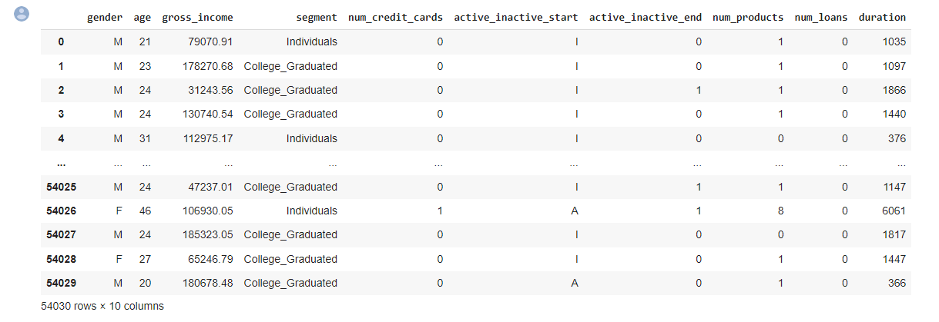
Slide 1
Data Set Details:
Columns
10
Null Values
0
Duplicated Values
1191
Rows
54030
Unique Values
55806

Slide 7

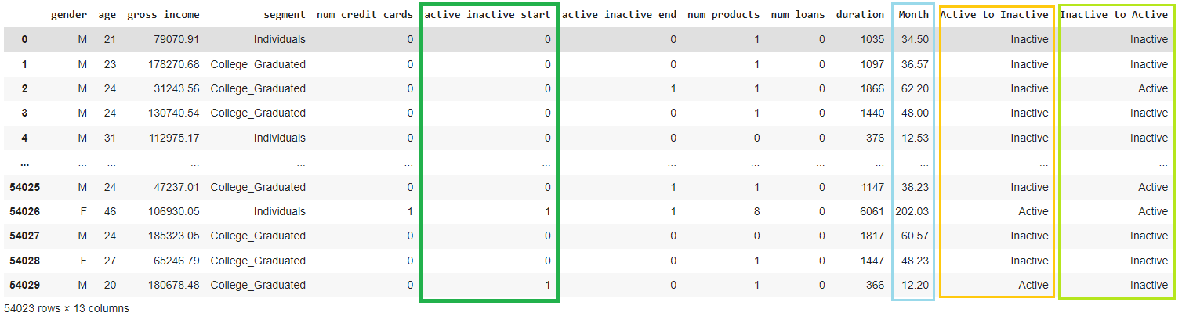
Data Cleaning :
As 'active_inactive_start' is an object data type, we replace the values with 1 for 'A' and 0 for 'I'
The data does not have any missing values or null values.

Slide 8
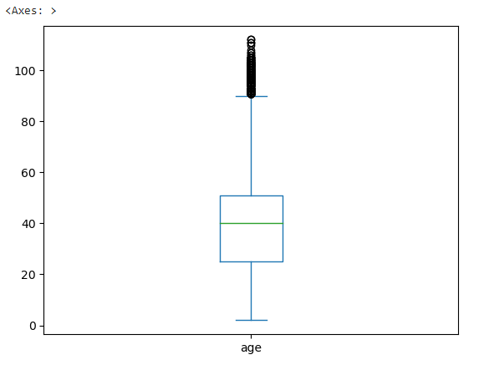
Detected Outliers:
We could see, here the column "Age" has extreme values (outliers), which should be cleaned.
Box Plot
Min Age: 2
Max Age: 112
Age_Median: 40
Percentage of outliers = 1.3 %
Skewness = 0.7034
Skewness between 0.5 to 1 could be considered as the data is positively skewed

Slide 9
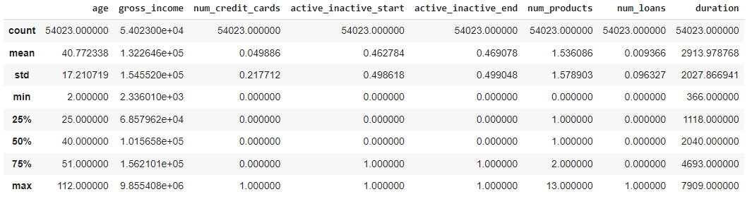
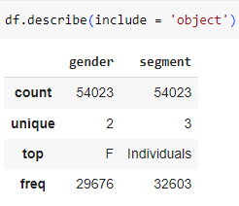
Statistical summary of Numeric & Categorical variables
The lower limit of the Age is 14 The Upper limit of the Age is 90
The upper limit of Gross Income is 1 Crore. Data consists of 7 rows, so we have eliminated those rows
Imputed data points <14 and >90 --> Median
Checking for summary of the numerical variables
Checking for summary of the categorical variables

Slide 10





Exploratory Data Analysis

Slide 11



Sample 9
Exploratory Data Analysis
Performing Exploratory Data Analysis to comment on what information the dataset conveys and if it’s complete/suitable to solve the given business problem. And also exploring for any patterns/ insights that might guide in addressing the overall business problem.
Male 24349
Female 29681
Uni-Variate and Bi-Variate
Distributions

Slide 12
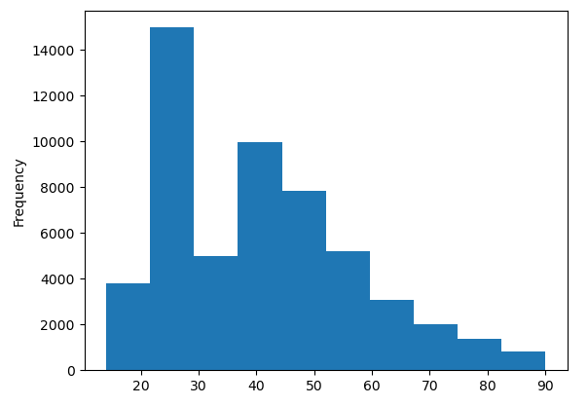
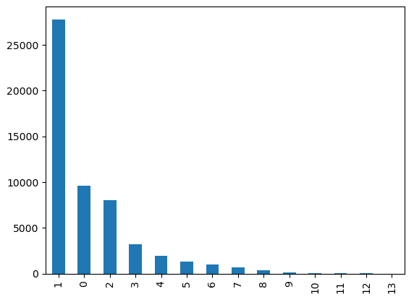
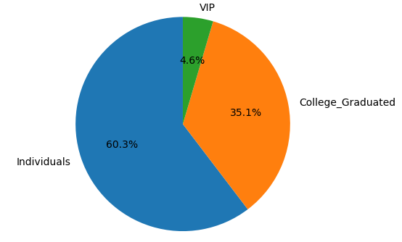
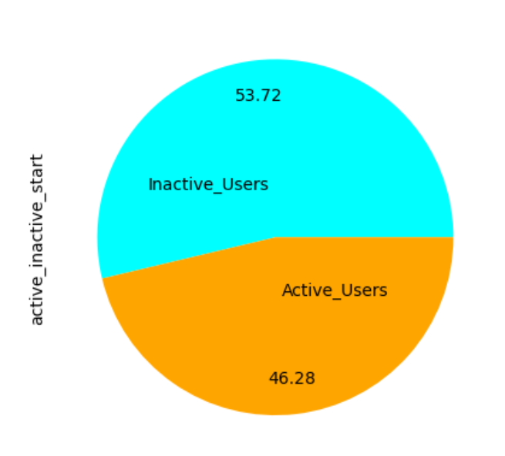
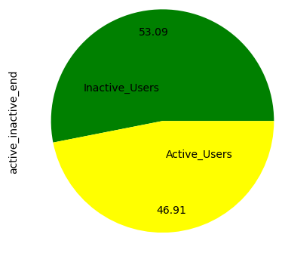
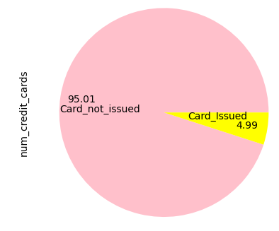
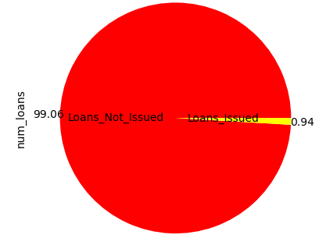
Univariate for Categorical & Numerical Variables
Segment wise Distribution
Age wise Distribution
Distribution for Number of Financial Products
Active_Inactive at the beginning
Active_Inactive end of 6 months
Percentage of CC issued
Percentage of Loans Issued

Slide 13
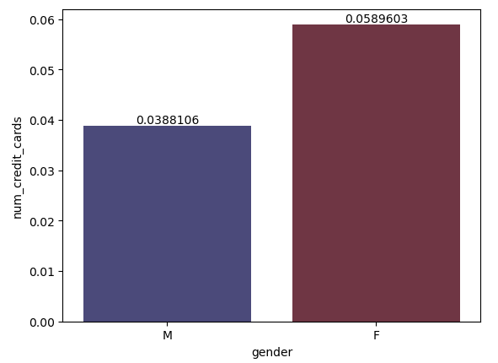
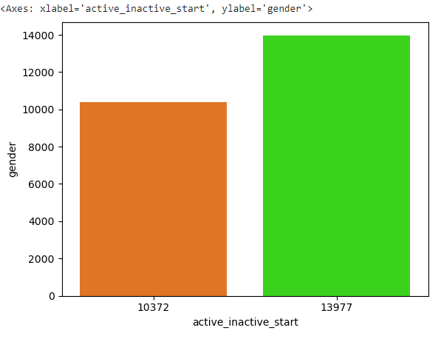
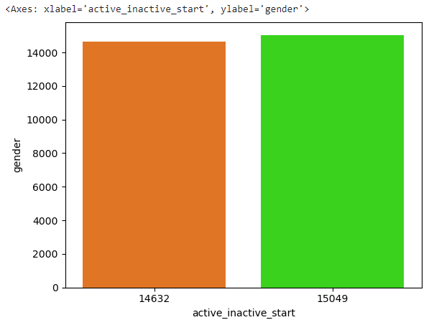
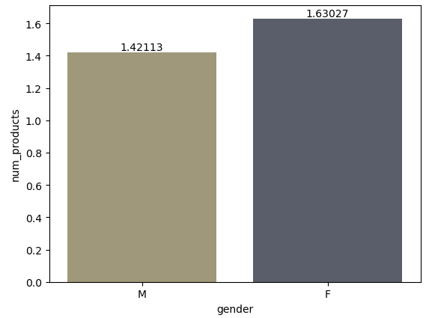
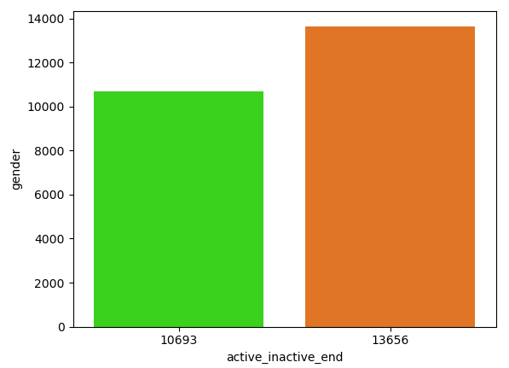
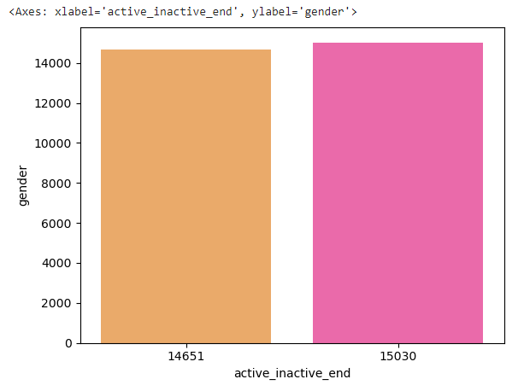
Slide 2
Bivariate Distribution based on the Gender
Number of Credit cards based on Gender
Active/Inactive status in the beginning of the period - Gender (Female)
We can see that Females have more ‘Credit Cards’ and other ‘Financial products’ as compared to Males.
Active/Inactive status in the beginning of the period - Gender (Male)
The Female proportion of ‘Activity to Inactivity’ is lower as compared to the Males
Distribution based on the Gender
Active/Inactive status at the end of the period - Gender (Male)
Active/Inactive status at the end of the period - Gender (Female)

Slide 14
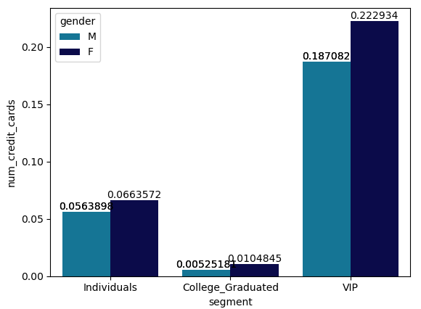
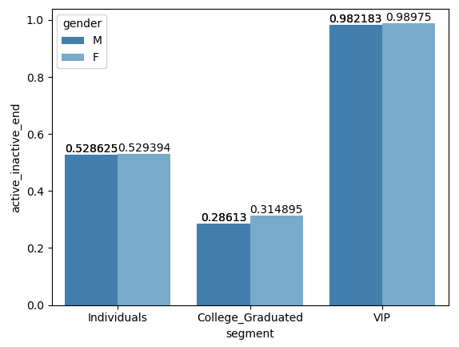
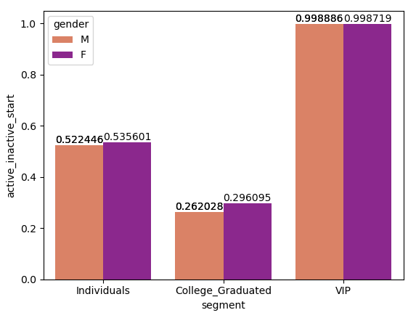
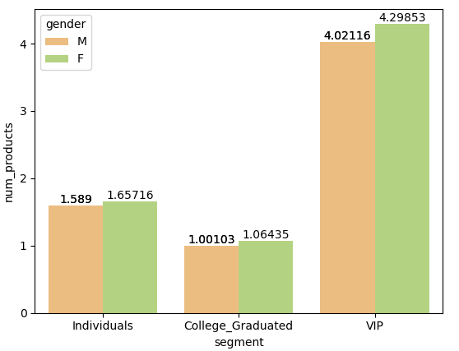
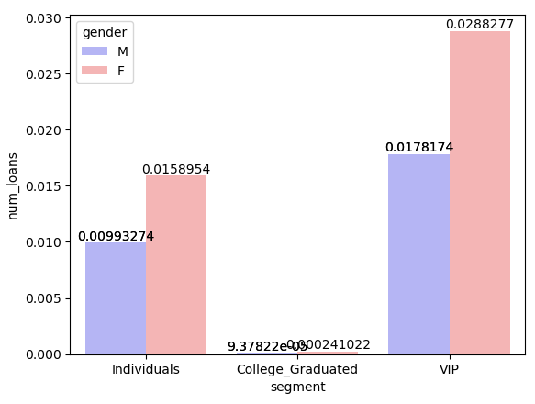
Bivariate Distribution based on the Segments
Number of Credit cards based on Gender (Segment Wise)
Active/Inactive End based on Gender (Segment Wise)
Number of Credit cards based on Gender
Active/Inactive Start based on Gender
Active/Inactive End based on Gender
Number of Products based on Gender
Number of Loans based on Gender
Active/Inactive Start based on Gender (Segment Wise)
Number of Products based on Gender (Segment Wise)
Number of Loans based on Gender (Segment Wise)

Slide 15
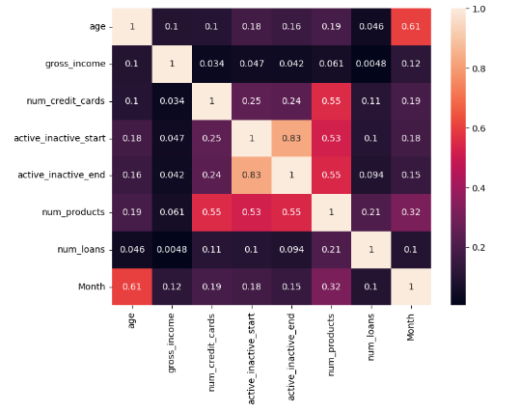
Multivariate Analysis Distribution
There is a moderate relationship between the number of credit cards and the number of financial products.
Duration and Age exhibit a correlation with each other.
The number of Products is associated with the customer's activity status.
There is a precise relationship between the number of products and the active_inactive_start and active_inactive_end variables.

Slide 16

KPI/ Metric based questions
These questions have a specific ask (pin-pointed) and getting to the required outcome is quite straight forward.

Slide 17

1. What % of customers were active before the 6 months period? What was this % at the end of 6 months period?
46.27 % of customers were active at the beginning of 6 months period.
46.90 % of customers were active at the end of 6 months period.

Slide 18


Slide 7
22903
Customers who remained Active
42 %
2438
Active customers who became Inactive
4.5 %
2098
Inactive customers who became Active
3.8 %
2. Get the count of the below customers: I. Customers who remained active II. Customers who remained inactive III. Active customers who became inactive IV. Inactive customers who became active
26584
Customers who remained Inactive
49 %

Slide 19
3. Four types of customers identified in our Data Set, perform a comparison on the below metrics and report any significant difference :
III. Average Duration
Active_Customers (Duration) : 3304.83
Inactive_Customers (Duration) : 2561.09
Active_to_Inactive_Customers (Duration) : 3427.45
Inactive_to_Active_Customers (Duration) : 2648.24
IV. Average number of Credit Cards
Active_Customers : 0.12
Inactive_Customers : 7.52
Active_to_Inactive_Customers : 0.006
Inactive_to_Active_Customers : 0
V. Average number of Loans
Active_Customers (num_loans) : 0.02
Inactive_Customers (num_loans) : 0
Active_to_Inactive_Customers (num_loans) : 0.01
Inactive_to_Active_Customers (num_loans) : 0
I. Average Gross income
Active_Customers (Gross_Income) : 140800.24
Inactive_Customers (Gross_Income) : 125685.11
Active_to_Inactive_Customers (Gross_Income) : 133109.92
Inactive_to_Active_Customers (Gross_Income) : 123093.65
II. Average Age
Active_Customers (Age) : 43.70
Inactive_Customers (Age) : 37.60
Active_to_Inactive_Customers (Age) : 43.93
Inactive_to_Active_Customers (Age) : 39.44

Slide 20
4. For Female and Male customers, perform a similar comparison on the below metrics and report any significant difference:
Active Customers
Inactive Customers
Active to Inactive Customers
Inactive to Active Customers
F 139230
M 142995
F 127779
M 123440
F 138336
M 125013
F 126739
M 118970
I. Average of Gross income
F 44
M 42
F 39
M 35
F 46
M 40
F 42
M 36
II. Average of Age
F 3506
M 3022
F 2845
M 2256
F 0.1299
M 0.0983
F 0.00014
M 0
F 0.02583
M 0.01424
F 0
M 0
F 3833
M 2799
F 2897
M 2365
F 0.0070
M 0.0060
F 0.0023
M 0.0008
F 0.0133
M 0.0097
F 0
M 0
III. Average of Duration
IV. Average of No. of Credit Cards
V. Average of No. of Loans

Slide 21
5. For customers of different segments (Graduates, Individuals, VIPs) perform a similar comparison on the below metrics and report any significant difference:
Active Customers
Inactive Customers
Active to Inactive Customers
Inactive to Active Customers
Graduated - 120964
Individuals - 141287
VIP - 176125
Graduated - 113454
Individuals - 136944
VIP - 361476
Graduated - 102603
Individuals - 1439128
VIP - 137650
Graduated - 104175
Individuals - 135300
VIP - 164102
I. Average of Gross income
Graduated - 24
Individuals - 47
VIP - 54
Graduated - 24
Individuals - 49
VIP - 50
Graduated - 23
Individuals - 51
VIP - 58
Graduated - 24
Individuals - 49
VIP - 55
II. Average of Age
Graduated - 1377
Individuals - 3696
VIP - 4496
Graduated - 1230
Individuals - 3788
VIP - 4521
Graduated – 0.30
Individuals – 0.12
VIP – 0.212
Graduated - 0
Individuals – 0.000145
VIP - 0
Graduated – 0.00063
Individuals – 0.0264
VIP – 0.0251
Graduated - 0
Individuals - 0
VIP - 0
Graduated - 947
Individuals - 4339
VIP - 2251
Graduated - 1271
Individuals - 3543
VIP - 730
Graduated – 0.0018
Individuals – 0.0085
VIP - 0
Graduated - 0
Individuals – 0.0027
VIP - 0
Graduated - 0
Individuals – 0.0164
VIP - 0
Graduated - 0
Individuals - 0
VIP - 0
III. Average of Duration
IV. Average of No. of Credit Cards
V. Average of No. of Loans

Slide 22
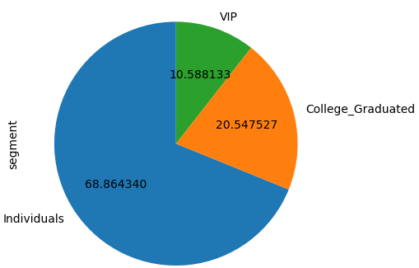
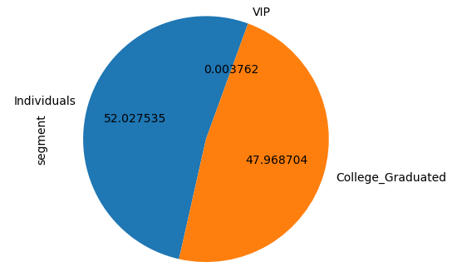
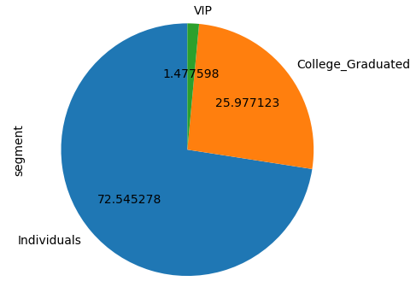
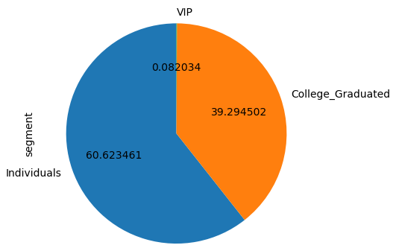
6. For each of the segments (Graduates, Individuals, VIP), find out the % of customers who: I. Who remained active II. Who remained inactive III. Who became inactive IV. Who became active
Customers who remained ‘Active’ based on segments
Customers who remained ‘Inactive’ based on segments
‘Active’ customers who became ‘Inactive’
‘Inactive’ customers who became ‘Active’

Slide 23





Sample 4
Open-ended Questions and recommendations
These are business-oriented questions which do not tell much about the kind of expected outcome, rather they require you to check if a certain phenomenon is occurring or not, or whether there is plausibility of a certain pattern.

Slide 24
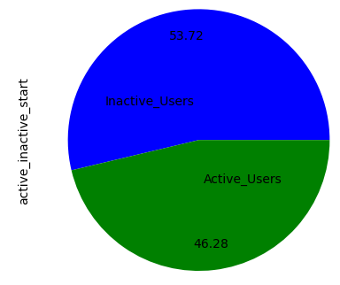
Business Problem :
Based on the Activity status :
It is evident that Inactive Users are more compared to Active users at both the beginning and end of the 6 months
Customers who remained active : 22903
Customers who remained inactive : 26584
Active/Inactive in the beginning of 6 months
Active/Inactive at the end of 6 months

Slide 25
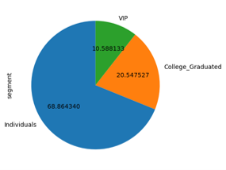
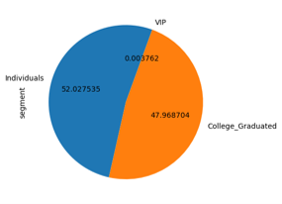
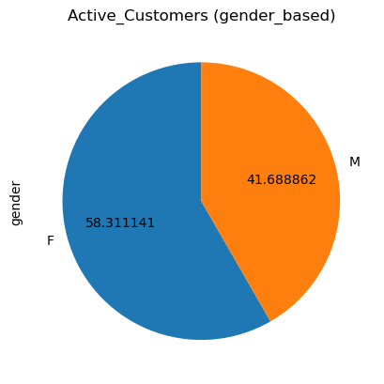
Activity status of customers- Segment-wise comparison/analysis
Customers who remained active
Customers who remained inactive
Customers who remained Active (Gender Wise)
By looking at all the above graphs we can see that Individuals seem to be more active compared to other segments

Slide 26
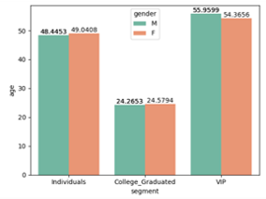
Analysis Based on Segment, Age, and Gender
Active Customers
F 45
M 42
Inactive Customers
F 40
M 35
Active to Inactive Customers
F 46
M 40
Inactive to Active Customers
F 41
M 36
Count of customers by age
Customers who remained active
Most of the customers seem to be between the age of 20 and 30 are college graduates and individuals
By all the above graphs we can infer that Female Individuals with the average age of 45 seem to be most stable and active user
We can also see that Male College Graduates seems to be unstable and inactive compared to other segments.​
The Average age of customers by segment

Slide 27
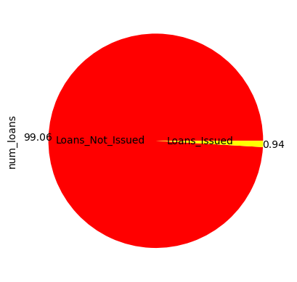
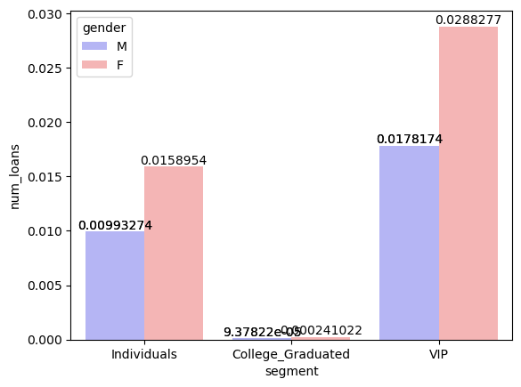
Approach –
Based on Loans :
Loans issued/not issued
Utilization of loans segment-wise
From the above graphs we can see that the bank has issued loans to only 1% of the customers from which most of it is utilized by VIPs
So if the banks choose to approach by issuing more loans to avoid churn its feasible to concentrate on female VIPs followed by individuals as well as they tend to take more loans compared to others

Slide 28
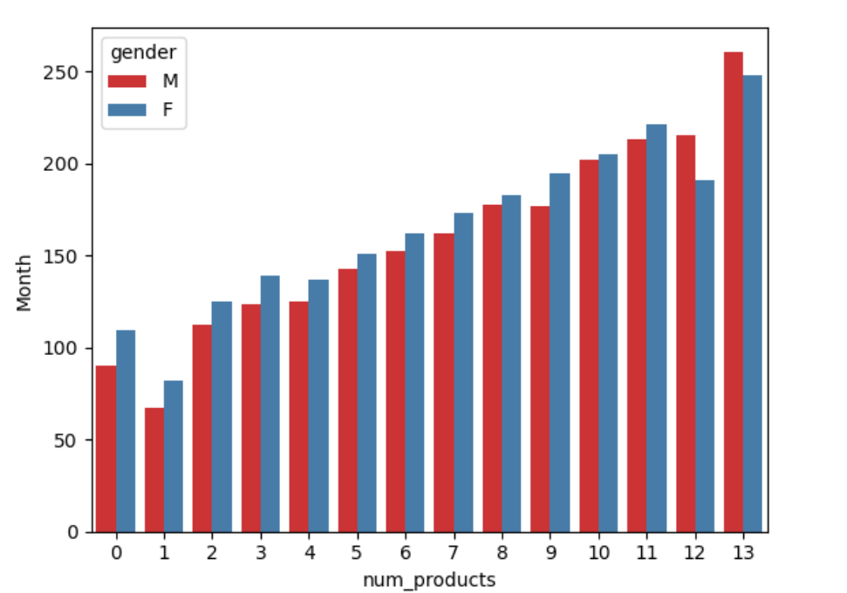
Approach –
Based on Duration & No. Of Products
Relationship between duration and no of products
By the above graph/analysis, we can clearly see that the longer the customer stays with the bank the more products they seem to utilize from the bank and stay more active compared with others

Slide 29
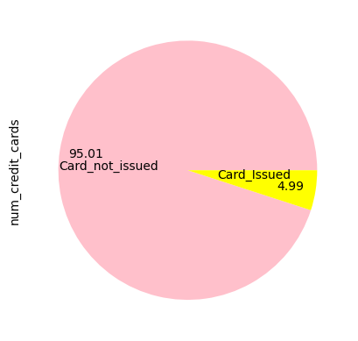
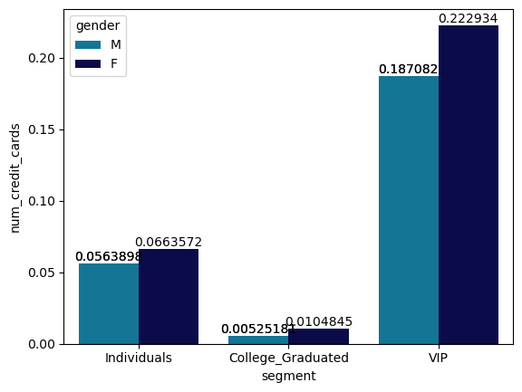
Approach –
Based on Credit & No. Of products
Looking at the above graph we can see that only 5% of customers have credit cards and most of it is used by VIPs and individuals
So if the banks choose to approach by issuing more loans to avoid churn its feasible to concentrate on female VIPs followed by individuals as well as they tend to take more loans compared to others
Percentage of Credit Cards issued
Percentage of Credit Cards issued (Segment wise)

Slide 30

Conclusion:
We finally conclude that if the bank wants to retain the customers from their existing segments the bank should concentrate on the Female individuals whose average age is 45 with highest duration with the bank as they seem to be most active and stable customers
If the bank wants to avoid churn it should get rid of the most inactive users that is college graduates who don’t seem to utilize any product from the bank
Out of the approaches we have analyzed the bank could choose the most feasible option to improve its current retention state

Slide 31


Thank You
Amit Mansukhani
Narmada Kumar
Sai Rakesh
Shaik Arif
Divya.L
Ankita
Bhawana Gupta

